Slide 1
Engineered Wood Products Primer
Awareness Guide
Ray O’Brocki, CBO
Manager - Fire Service Relations
American Wood Council

Slide 2
Purpose of this guide
This guide reviews the history and development of engineered wood products in the marketplace and provides definitions that enable a fire service instructor to identify these lightweight products as they are used in building construction.

Slide 3
About AWC
Codes and Standards
Sustainability
Manufacturing Environmental Regulation
Advocacy and Public Policy

Slide 4
Education Resources
www.awc.org
Education Tab

Slide 5
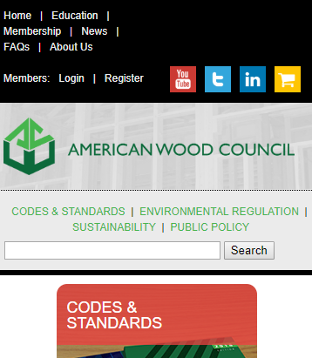
To expedite your CEUs, create an account on our website!
www.awc.org

Slide 6
Education Resources
In-Person Seminars
Monthly Webinars
Recorded Presentations
CEUs Available
www.awc.org/education education@awc.org

Slide 7
Code Official Connections
Free to Qualified Officials
Free Standard
Pubs Discounts
WoodPost Newsletter
WoodWorks Software
www.awc.org/codeconnections membership@awc.org

Slide 8
Learning Objectives
Upon completion, participants will be better able to:
1
Background
3
Engineered Wood Products
Discuss the background and origin of engineered wood products
Define Engineered wood products and give examples
2
Manufacture
4
Fire Performance
Identify methods for the manufacture of engineered wood products
Understand fire testing of engineered wood products

Slide 9
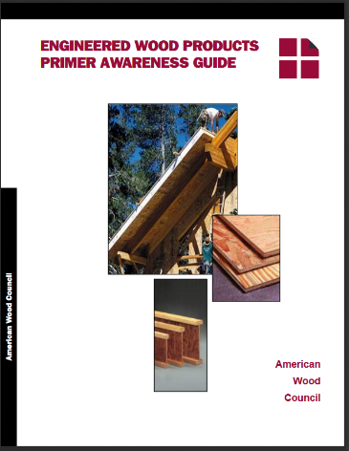
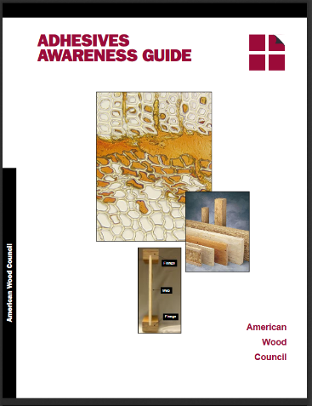
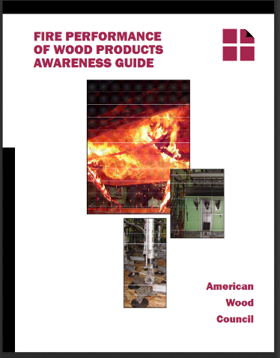
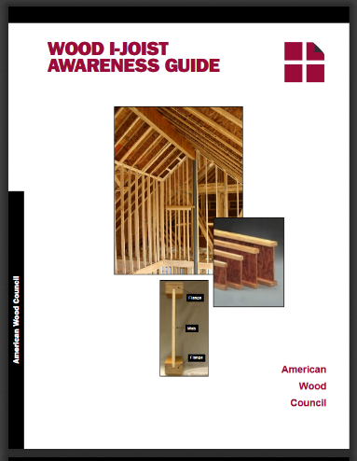
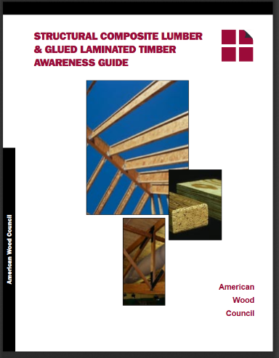
Meeting fire service needs
This series of Awareness Guides has been prepared to “train the trainer” and begin to inform the fire service in a uniform manner about new wood product construction materials and methods being used in the marketplace
The wood products industry is committed to delivering educational material to the fire service with the goal of reducing risk of injury from structural collapse in fires
Notes:
The level of training and technical support available from the building industry has increased dramatically in the past twenty years. Engineered wood product specialists are now common in the construction industry and software has helped to communicate the intricacies of the many new products. Until now, however, the available information has not been uniformly provided to the fire service.

Slide 10
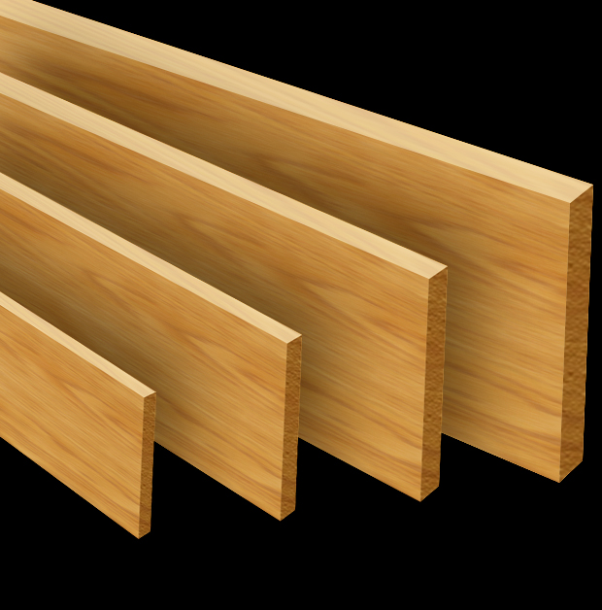
Background/ History - 1950’s
After World War II, the explosive growth of American suburbs was unlike any other time in history
In the 1950s, most homes were constructed with solid sawn lumber framing, with diagonal board sheathing placed on floors, walls, and roof
Hardwood plank flooring was commonplace
Notes:
the past fifty years have seen unprecedented changes in building construction. The changes in wood frame construction during this period have also been significant, paralleling the numerous changes within the fire service..

Slide 11
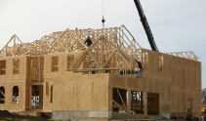
Background/ History - 1960’s
In the 1960s, plywood sheathing had become common for floors, roofs, and walls, and the use of trusses in roofs had replaced rafters
Additionally, carpeting had become the preferred flooring choice
Pitch chord roof trusses
are lifted into place over
the garage
Notes:
The wood industry has adapted to a number of opportunities and constraints. As a result, there are many lightweight structural products and construction techniques for building residential wood frame houses

Slide 12
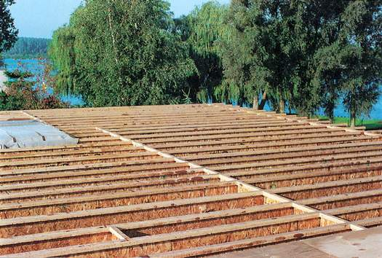
Engineered Lightweight construction
In the 1980s, both environmental limitations and consumer demand spurred the transition to engineered lightweight wood construction.
Wood industry developed technology to “disassemble” smaller logs and glue them back together lighter and stronger.
The square footage of residential homes was increasing, along with demand for deep, long, and straight building materials
I-joist floor framing
Notes:
Environmental constraints reduced the size of trees delivered to saw mills.
It had become impossible to make a 20-foot long 2x12 floor joist out of a 9-inch diameter tree, or plywood out of 6-inch tree tops that were full of knots.
At the same time, coupled with environmental constraints, consumers expected the forest products industry to use fewer trees with greater efficiency and less waste

Slide 13
New Design Standards
Design and material standards for new structural products also began to change
Previous standards had been prescriptive
The newer standards developed were instead based on performance
Building code organizations developed evaluation services to manage approval of newer products as alternatives to those already listed in the building code
Notes:
Prescriptive- For example, by this cookbook approach, plywood or another panel product would have to be manufactured according to a strict recipe designating adhesives to be used and type and dimension of materials.
Performance- A product could be manufactured with any adhesive, as well as type or dimension of material, as long as it performed in accordance with the requirements of manufacturing standards and the building code.

Slide 14
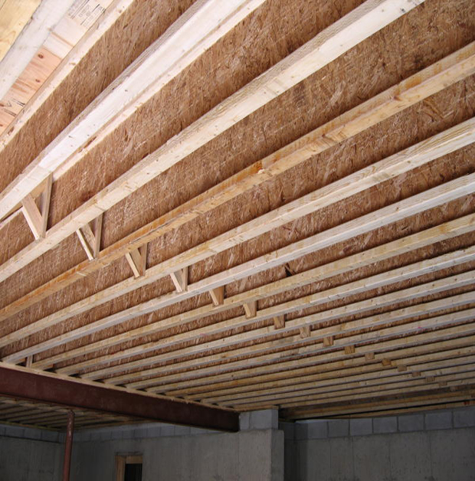
Defining engineered wood products
Different opinions as to what is an engineered wood product
From the fire service perspective, any product consisting of a combination of smaller components into a structural member and designed using engineering methodologies should be considered engineered
IBS bridging is a manufactured wood bridging product
that can be used with I-joists to
increase stiffness and reduce bounce and vibration
Notes:
In response to consumer demands, the wood industry developed technologies to use smaller trees more efficiently. These technologies moved homebuilding to a new era of more fiber-efficient and lightweight engineered materials—thus the term “engineered wood products.”

Slide 15
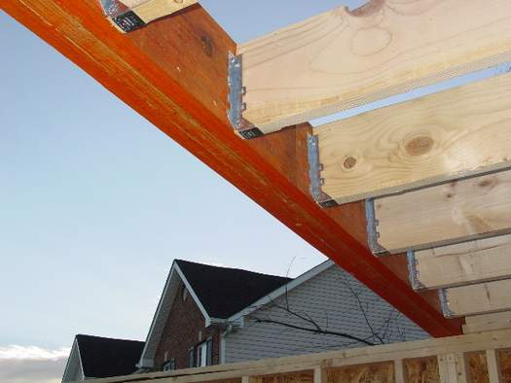
Defining engineered wood products
Engineered products are developed to use materials efficiently
Many engineered wood products are lighter in weight than the conventional product they are designed to replace
Lumber joists are supported in metal joists
hangers that are nailed to the face of a large
LVL header
Notes:
Most of these products are proprietary (uniquely de-signed from a specific manufacturer) and are marketed under different trade names. Each of these products, however, has to comply with building code requirements be-fore its use in structural applications.

Slide 16
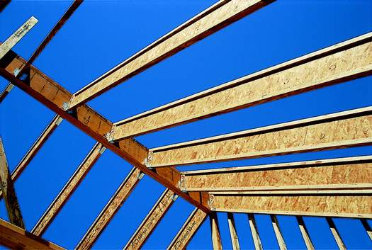
Defining engineered wood products
For the sake of definition here, engineered wood products are structural components or assemblies that are offered as alternatives to solid sawn lumber
Structural composite lumber
I-joists
Wood trusses
I-joist roof rafters, supported in metal
hangers, frame into an LVL ridge beam.
The ridge metal-joists are supported in
metal hangers.
Notes:
Most of these products are proprietary (uniquely designed from a specific manufacturer) and are marketed under different trade names. Each of these products, however, has to comply with building code requirements be-fore its use in structural applications.

Slide 17
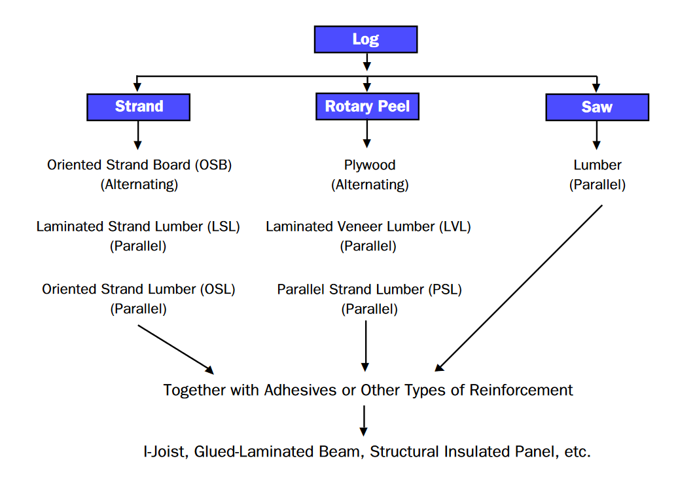
Manufacture of engineered wood products
There are three primary manufacturing methods to
dismantle a log and reassemble it into an engineered
wood product
stranding
peeling
sawing

Slide 18
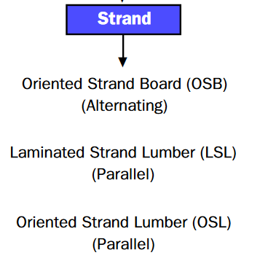
Stranding
Stranding
3-inch to 12-inch slices
similar to grating a block of cheese
Strands dried in large rotary drum
Adhesive applied
Strands dropped into forming bin
Pressed together
thin and flat sheets like plywood
long and wide like sawn lumber
Notes:
Stranding slices the entire log into 3-inch to 12-inch
strands, similar to grating a block of cheese. The strands
are dried in a large rotary drum, where an adhesive is
applied. The strands are then dropped into a forming bin
and pressed together to form the individual products.
These products can be thin and flat sheets, like plywood,
or long and wide, like sawn lumber.
Stranding is the most efficient method to convert a log into an engineered wood product, because it uses the smallest pieces. Smaller strands pack more efficiently into rectangular sections. The net result is in-creased utilization of a tree and less waste delivered to the landfill.

Slide 19
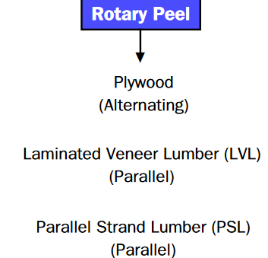
Rotary Peel
Rotary peeling involves placing a long knife parallel to the outside edge of a spinning log
The knife peels slices off the log like paper towels off a roll
The wood slices are then clipped into individual sheets (called veneer), which are dried, glued, and pressed together to form the product
Notes:
Peeling the log is not as efficient as stranding , but is still attractive to facilities that were established to peel logs but now want to manufacture engineered wood products

Slide 20
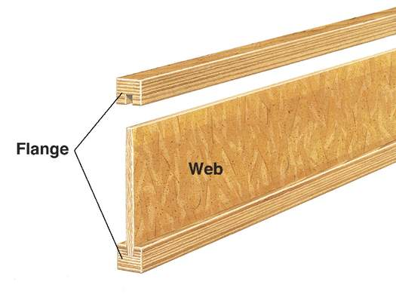
Sawing
Sawing involves cutting a log into common rectangular sections, such
as 2x3 or 2x4
The lumber is dried and cut to length before assembly as an engineered wood product, such as trusses or I-joist flanges

Slide 21
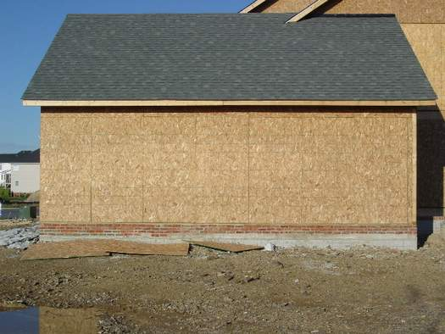
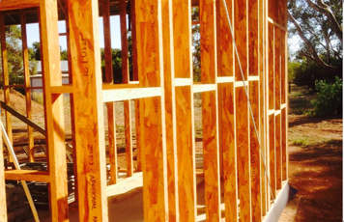
Strand products
There are three primary types of wood products
manufactured from strands
Oriented strand board (OSB)
Laminated strand lumber (LSL)
Oriented strand lumber (OSL)

Slide 22
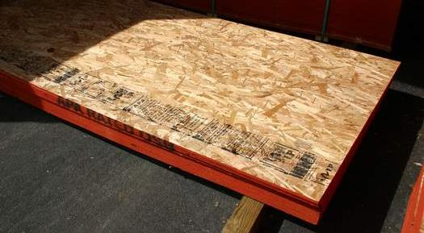
Strand products – OSB
OSB most often is used as panels and as a lumber substitute
OSB is formed by alternating the layers of strands perpendicular to the previous layer, which provides bending support in two directions
Notes:
The strands are up to three inches long (see more information on this product in the Wood Structural Panel Awareness Guide in this series).

Slide 23
Strand products – LSL
LSL most often is used as a lumber substitute and as flanges in I-joists
The strands used are up to 12 inches long and in manufacture are placed parallel to each other
Notes:
OSL has uses similar to LSL. It is fabricated with shorter strands, up to six inches long.

Slide 24
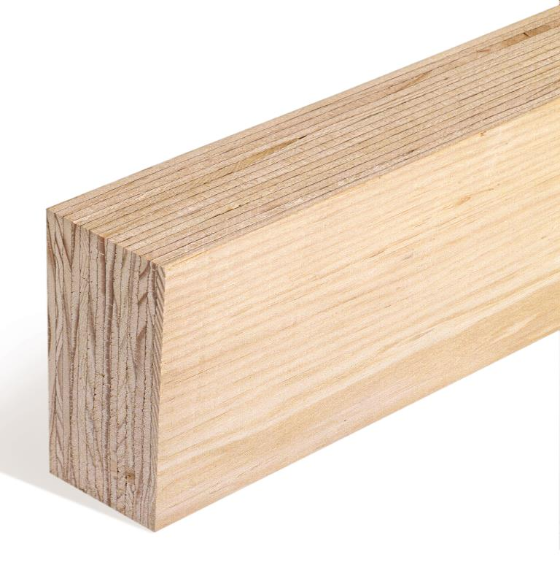
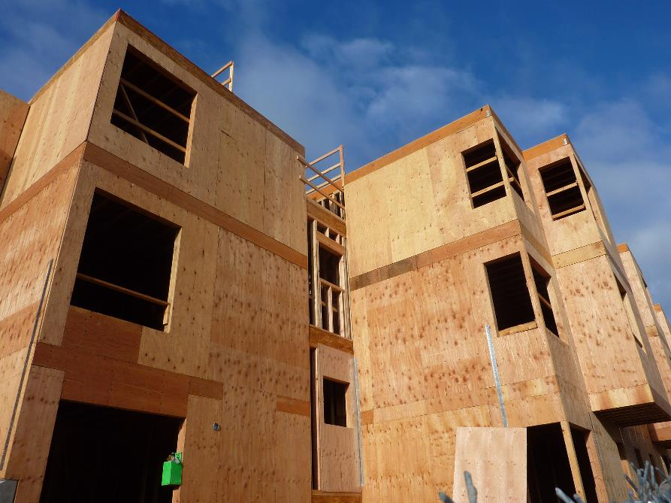
Peel Products
There are three primary wood products manufactured using peeling technology
Plywood
Laminated veneer lumber (LVL)
Parallel strand lumber (PSL)
Courtesy of APA — The Engineered Wood
Association
Notes:
Picture (right) plywood sheathing, Picture (left) Laminated Veneer Lumber (LVL)

Slide 25
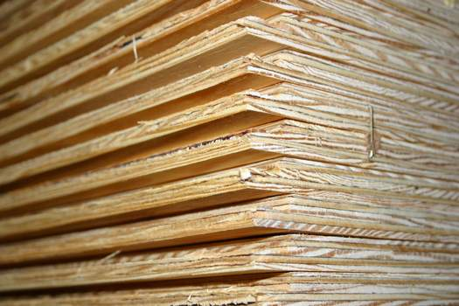
Plywood
Plywood most often is used as structural panels
Plywood is manufactured by alternating veneer perpendicular to the
previous layer, which provides bending support in two directions
Plywood is also referred to as a “wood structural panel”
Exterior plywood sheathing is fabricated with an overlapping edge to prevent
water intrusion into the wall cavity
Notes:
See more information on this product in the Wood Structural Panel Awareness Guide in this series.

Slide 26
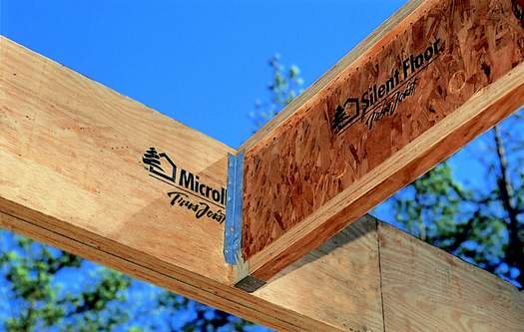
Laminated Veneer Lumber (LVL)
LVL most often is used as a lumber substitute and as flanges for
I-joists
The layers of veneer are staggered to disperse the joints between
veneer segments
An I-joist is support by Laminated
Veneer Lumber (LVL) attached by a joist hanger

Slide 27
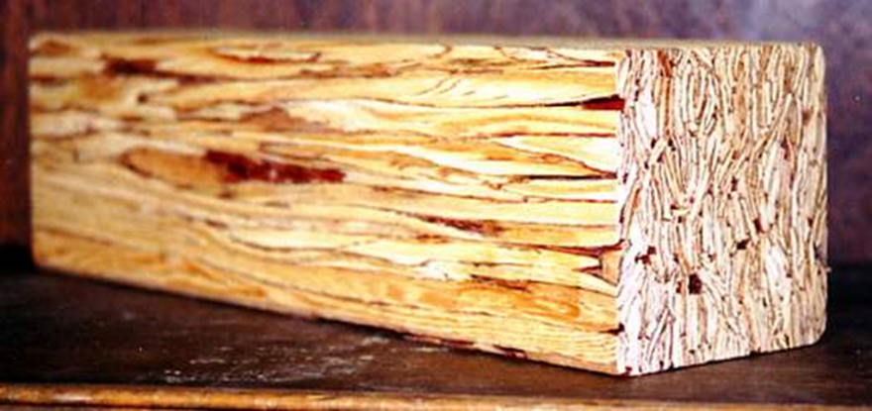
Parallel Strand Lumber (PSL)
PSL is manufactured from veneer clippings that are too narrow for LVL or plywood
The PSL process involves clipping the veneer to less than one inch
wide, coating the clippings with resin, and forming them into large
dimension cross-sections similar in size to heavy timber
Parallel strand lumber (PSL) - is a high
strength structural composite lumber
product manufactured by gluing strands of wood together under pressure. It is a proprietary product marketed under the
trade name ParaIlam®
Notes:
Parallel strand lumber is fabricated from slices of veneer, combined with adhesive and formed into large billets that are sawn into more useable dimensions.

Slide 28
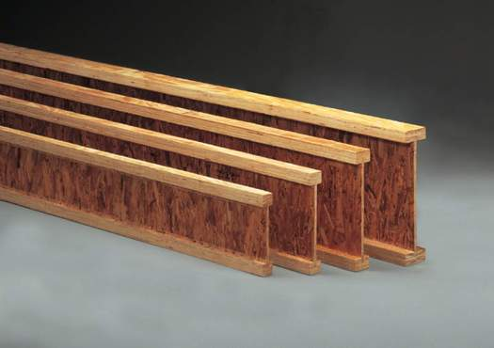
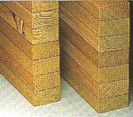
Multiple Components
An engineered wood product may consist of multiple engineered
components. For example, an I-joist can have OSB as the web, and
lumber or structural composite lumber as the flanges.
Notes:
A glued-laminated timber (GLULAM) beam is an engineered assembly of specially graded lumber. A truss is an engineered assembly often comprised of sawn lumber chords and wood or metal webs.

Slide 29
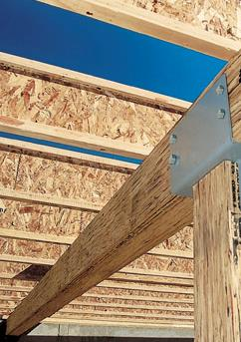
Why use engineered wood products?
Produced to longer lengths than sawn lumber
Product consistency
PSL is a high strength SCL product manufactured by gluing wood strands together under pressure
Notes:
EWP technology did not come without a cost. It is more expensive to peel, strand, glue, and press together a2x12 than to cut that dimension directly from a log. Added costs, coupled with certain environmental expectations to reduce harvesting, fueled development and the resulting popularity of lightweight engineered materials. Products such as I-joists use 50% less fiber than a rectangular piece of lumber of the same width.

Slide 30
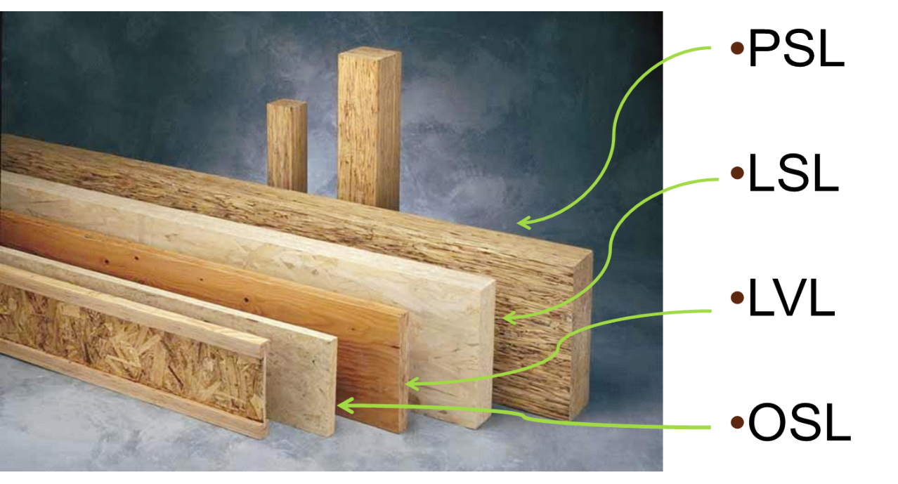
Fire Performance of EWP
Fire testing of engineered wood products is required to satisfy building code provisions
There are no structural fire performance requirements for single family homes
Multi-family housing and commercial structures may require fire-rated assemblies – ASTM E 119 Test
Notes:
To comply, a manufacturer would need to supply qualifying ASTM E119 test reports on wall or floor assemblies as proof of compliance to applicable code provisions.

Slide 31
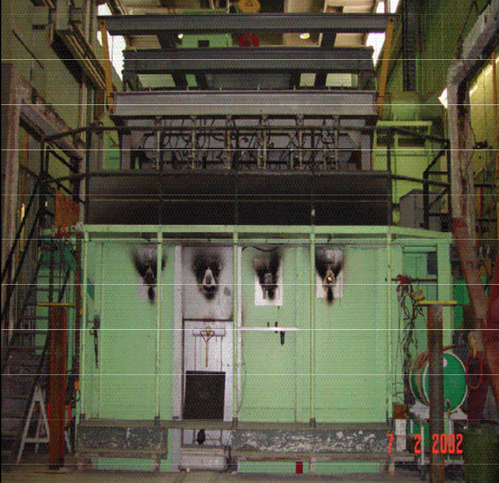
What is the ASTM E 119 Test?
Intended to evaluate duration for which types of building elements contain a fire, and retain structural integrity during predetermined test fire
Pass/Fail Criteria based on peak temperature attained at back of test assembly or material
Whether test assembly or material distorts or collapses and allows hot gases to escape
Whether wall can withstand hose stream pressure
Full-scale floor-ceiling test furnace for performing fire tests in accordance with
ASTM E119
Notes:
The test is intended to evaluate the duration for which the types of building elements contain a fire, retain their structural integrity during a predetermined test fire.
The Pass/ Fail Criteria is based upon the peak temperature attained at the back of the test assembly or material;
And/or whether the test assembly or material distorts or collapses that allows hot gases to escape, and;
Whether the wall can withstand the pressure of a hose stream

Slide 32
Fire Performance of SCL and GLULAM
Glulam and SCL, although composed of smaller pieces of wood that are adhered together, offer the same fire performance as sawn members of similar size because the adhesives used in their manufacture does not adversely affect fire performance.*
*Malhotra, H. and Rogowski, F., “Fire Resistance of Laminated
Timber Columns,” Proceedings of Symposium No. 3. Her Majesty’s
Stationary Office, London 1970, pp. 16-51.
Glulam Header
Courtesy of APA-The Engineered Wood Association
Notes:
Glulam and SCL, although composed of smaller pieces of wood that are adhered together, offer the same fire performance as sawn members of similar size because the adhesives used in their manufacture does not adversely affect fire performance.*

Slide 33
Fire Performance of SCL and GLULAM
The fire performance of timber can be attributed to the charring effect of wood. As wood members are exposed to fire, an insulating char layer is formed that protects the core of the section. Beams and columns can be designed with a sufficient cross section to sustain the design loads for the required duration of fire exposure in the ASTM E 119 Test.*
*”ASTM E 119-88 Standard Test Methods for Fire Tests of Building
Construction and Materials,” in ATSM Test Standards, Philadelphia, PA, 1993, pp. 674-694.
LVL and plywood construction
Courtesy of APA-The Engineered Wood Association

Slide 34
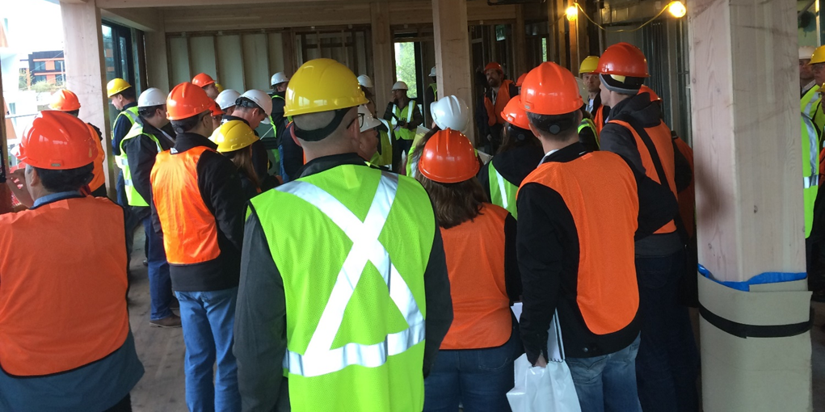
Building code certification of EWP
Model building codes require that engineered wood products be certified by an independent third-party certification agency
That independent agency must confirm that products meet the strict performance criteria required by building codes
Through regular and unannounced random audits at manufacturing facilities, certification agencies implement and closely monitor a rigorous quality control program
Notes:
Before submitting samples to a certification agency for testing and certification,
Engineered wood products manufacturers conduct regular, extensive, and monitored performance testing
During the auditing process, certification agency personnel review and verify quality control test results. They also collect and test samples (small and/or large) to ensure that the engineered wood product meets required performance criteria.

